Slide 1

TAFE EDUCATOR CONTENT GENERATOR
The Australian Energy Sector:
Systems, Standards, and Sustainability
Unit Introduction & Overview
TAFE NSW acknowledges the Traditional Custodians of the Land, Rivers and Sea. We pay our respect to Elders, past, present and emerging of all Nations.

Slide 2


Unit Overview
What We Will Cover
Learning Outcomes
This unit provides a comprehensive understanding of the Australian energy landscape. We will explore:
By the end of this module, you will be able to:
•
Navigate the National Electricity Market (NEM).
•
The complete energy supply chain from generation to retail.
•
Perform essential energy and cost calculations.
•
Apply AS/NZS 3598 standards to energy audits.
•
Regulatory bodies and who controls the grid.
•
Technical reporting and compliance standards.

Slide 3








The Energy Supply Chain
Generation
Transmission
Distribution
Retail
Production of electricity from thermal (coal, gas) and renewable sources.
High voltage transport over long distances via large interconnectors.
The 'poles and wires' network stepping voltage down for local use.
Companies that manage customer accounts and billing.

Slide 4

The National Electricity Market (NEM)
Connecting the East Coast
The NEM is one of the world's longest interconnected power systems.
•
Scope: Connects QLD, NSW, ACT, VIC, SA, and TAS.
•
Function: A wholesale market facilitating exchange between generators and retailers.
•
Note: WA and NT operate separate grid systems.

Slide 5
Power Generation: Thermal vs. Renewable
Thermal Generation
Renewable Generation
•
Base Load: Historically coal-fired stations running continuously to meet minimum demand.
•
Variable Renewable Energy (VRE): Solar and wind, dependent on weather conditions.
•
Peaking Plants: Gas turbines used during high-demand events (e.g., heatwaves).
•
Transition: Moving from centralized fossil fuels to decentralized renewables.
•
Dispatchability: High ability to turn on/off on command.
•
Challenge: Requires storage to ensure reliability.

Slide 6
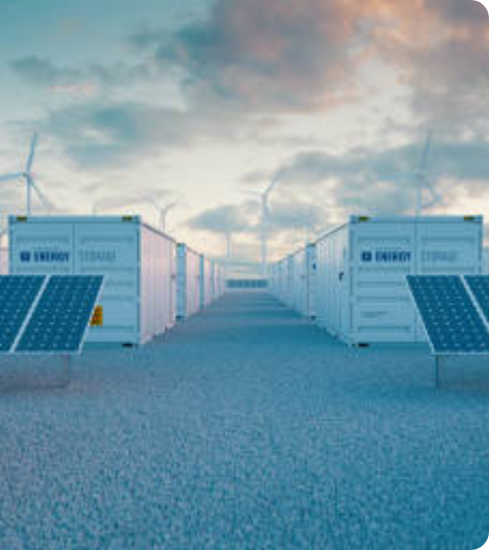
The Renewable Transition
From Centralized to Distributed
The grid is transforming physically and operationally.
•
NSW Roadmap: Construction of Renewable Energy Zones (REZs).
•
Storage: Critical role of Grid-scale Batteries and Pumped Hydro (e.g., Snowy 2.0).
•
Prosumers: Rooftop solar turning consumers into producers (DER).

Slide 7






Who Rules the Grid?
AEMO
AER
AEMC
Operator
Regulator
Rule Maker
Manages day-to-day systems and market clearing.
Enforces rules, monitors markets, and sets price ceilings.
Develops amendments to the National Electricity Rules.

Slide 8
Energy Pricing & Physics
Understanding Tariffs
Physics Fundamentals
•
Daily Supply Charge: Fixed cost (c/day) for connection.
•
Power (kW): Rate of energy use (Speed).
1 kW = 1,000 Watts
•
Usage Charge: Cost per unit (c/kWh).
•
Energy (kWh): Total work done (Distance).
1 kWh = 1 kW load for 1 hour
•
Time of Use (TOU): Rates vary by Peak, Shoulder, and Off-Peak times.
•
Scale: MW (Mega) and GW (Giga) used for grid scale.
•
Controlled Load: Specific tariffs for heavy appliances (hot water).

Slide 9


Calculation: Consumption & Cost
The Formulas
Example Scenario
1. Calculate Energy
A 2.4kW heater runs for 4 hours. The electricity rate is $0.30/kWh.
E ( kWh ) = P ( kW ) × t ( hours )
Step 1: Energy = 2.4 × 4 = 9.6 kWh
2. Calculate Cost
Step 2: Cost = 9.6 × 0.30 = $2.88
Cost = E × Rate

Slide 10




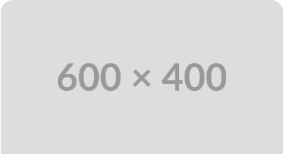
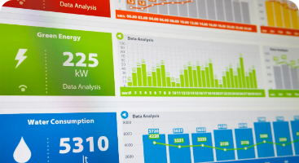
Standards: Energy Audits (AS/NZS 3598)
Type 1: Basic
Type 2: Detailed
Type 3: Precision
High-level overview, desktop analysis of bills, +/- 40% accuracy.
Site visit, monitoring key equipment, +/- 20% accuracy.
Extensive data logging, computer simulation, +/- 10% accuracy.

Slide 11
System Efficiency & GEMS
Understanding Efficiency
Using less energy to perform the same task.
GEMS Act: Greenhouse and Energy Minimum Standards legislation.
MEPS: Minimum Energy Performance Standards. Products below this cannot be sold.
Star Ratings: Every extra star is approx. ~20% saving on running costs.

Slide 12
Writing for the Energy Sector
Writing Style
Report Structure
•
Objective Tone: Factual and evidence-based.
•
Executive Summary: Summarizes findings for decision-makers.
•
Audience: Tailor language (Client vs Engineer).
•
Active Voice: "The technician tested the circuit" (Stronger).
•
Methodology: How data was collected.
•
Findings: Presentation of data/calculations.
•
Clarity: Avoid jargon; use bullet points.
•
Recommendations: Actionable steps with ROI.

Slide 13
Summary & Next Steps
Recap: Covered NEM structure, AEMO/AER roles, energy math, and audit standards.
Relevance: Essential skills for energy management and electrical trades.
Upcoming: Analyze a sample energy bill and draft a Type 1 Audit.
Questions?

Slide 14
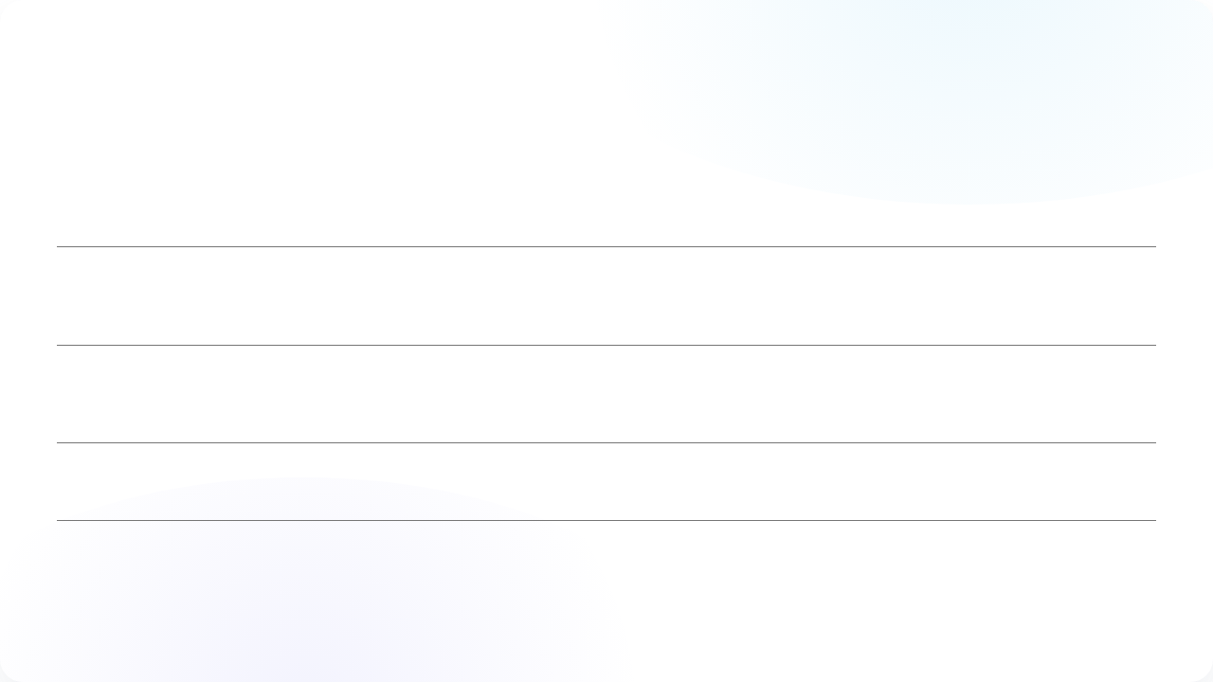





Image Sources
https://www.aemc.gov.au/sites/default/files/inline-images/NEM.png
Source: www.aemc.gov.au
https://media.istockphoto.com/id/1321274917/photo/battery-storage-power-station-accompanied-by-solar-and-wind-turbine-power-plants-3d-rendering.jpg?s=612x612&w=0&k=20&c=M4Wfd-p5FbXU1NXp_be308uDMgfhbCYNO_dPse4FJLY=
Source: www.istockphoto.com
https://media.istockphoto.com/id/1957093651/photo/an-inspector-reviews-a-large-industrial-plant-clipboard-in-hand.jpg?s=612x612&w=0&k=20&c=HCSJZEhAXG2m_DEMcOCcNeJYNkUAkjotoG5TBSMSr0Y=
Source: www.istockphoto.com
https://www.fescoenergy.com/app/uploads/2020/10/iStock-163716641.jpg.webp
Source: www.fescoenergy.com
https://www.energyrating.gov.au/sites/default/files/2023-03/Label-Energy-Energy-Rating.png
Source: www.energyrating.gov.au

